Slide 1


Slide 2

23
FINANCE, SAVING, AND INVESTMENT

Slide 3
After studying this chapter, you will be able to:
Describe the flows of funds through financial markets and the financial institutions
Explain how borrowing and lending decisions interact in financial markets
Explain the effects of government borrowing and lending in financial markets

Slide 4
Financial Institutions and
Financial Markets
  To study the economics of financial institutions and markets we distinguish between
  Finance and money
  Physical capital and financial capital
  Finance and Money
  The study of finance looks at how households and firms obtain and use financial resources and how they cope with the risks that arise in this activity.
  The study of money looks at how households and firms use it, how much of it they hold, how banks create and manage it, and how its quantity influences the economy.

Slide 5
Financial Institutions and
Financial Markets
  Physical Capital and Financial Capital
  Physical capital is the tools, instruments, machines, buildings, and other items that have been produced in the past and that are used today to produce goods and services.
  The funds that firms use to buy physical capital are called financial capital.
  (Hence, we always assume that firms will always borrow goods )

Slide 6
Financial Institutions and
Financial Markets
  Capital and Investment--recall ch20 slides 24,25
  Gross investment is the total amount spent on purchases of new capital and on replacing depreciated capital.
  Depreciation is the decrease in the quantity of capital that results from wear and tear and obsolescence.
  Net investment is the change in the quantity of capital.
  Net investment = Gross investment − Depreciation.

Slide 7
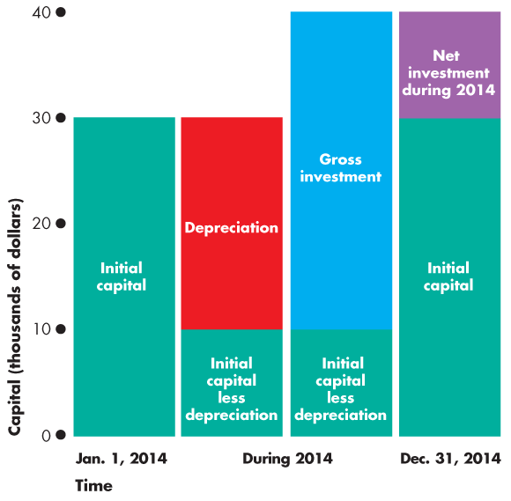
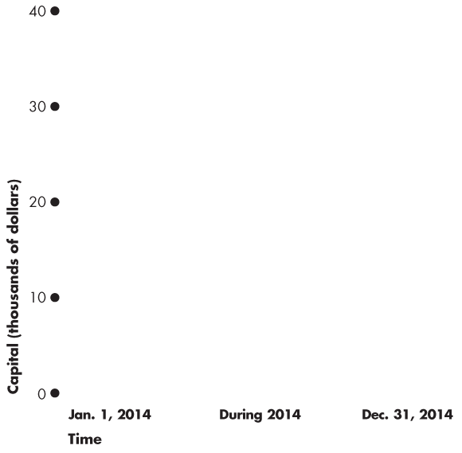
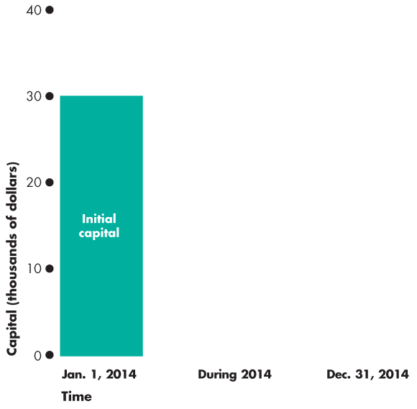
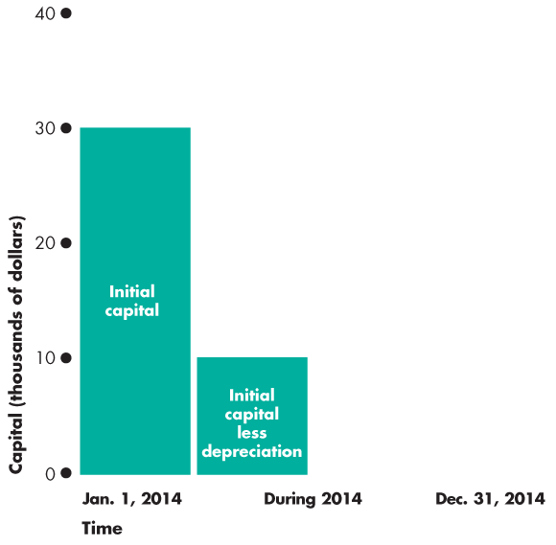
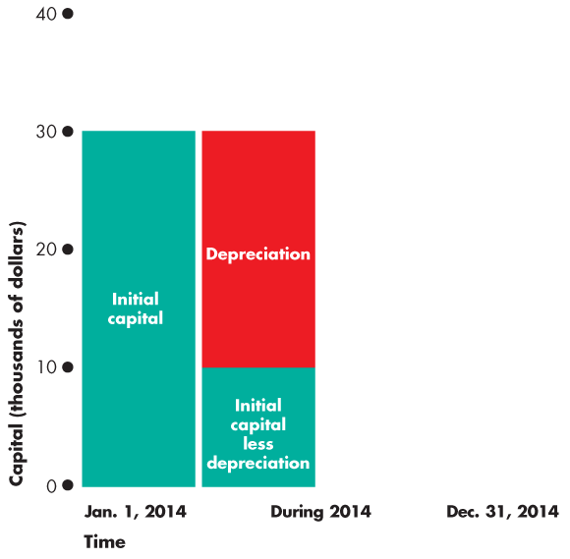
Financial Institutions and
Financial Markets
Net Investment=gross investment-depreciation
  Figure 23.1 illustrates the relationships among the capital,
  gross investment, depreciation,
  and net investment.

Slide 8
Wealth and Saving
  Wealth is the value of all the things that people own.
  -Income: money received during a period of time
  (Wealth>Income)
  Saving is the amount of income that is not paid in taxes or spent on consumption goods and services.
  S=Y-T-C (Saving=Income-Tax-Consumption)
  Saving increases wealth.
  Wealth also increases when the market value of assets rises—called capital gains—and decreases when the market value of assets falls—called capital losses.

Slide 9
Financial Institutions and
Financial Markets
  Financial Capital Markets
  Saving is the source of funds used to finance investment.
  (firms gets money from the bank, who gets money from us)
  These funds are supplied and demanded in
  three types of financial markets:
  Loan markets
  Bond markets
  Stock markets

Slide 10
Three types of financial markets
  Loan markets
  Firms borrow for a variety of reasons
  Households borrow to buy big-ticket consumption goods and new homes
  Bond markets
  A bond is a debt instrument. The issuer promises to make pyments on specified dates. There are a variety of types and conditions.
  Stock markets
  A stock is a share of ownership

Slide 11
Financial Institutions and
Financial Markets
  Financial Institutions
  A financial institution is a firm that that operates on both sides of the markets for financial capital.
  It is a borrower in one market and a lender in another.
  Key financial institutions are
  Banks
  Trust and Loan Companies
  Credit Unions and Caisses Populaires
  Pension funds
  Insurance companies

Slide 12
Key financial institutions
(both borrowers and lenders)
  Banks
  Borrower- accept deposits
  Lender- buys govenment bonds and securities
  Trust and Loan Companies
  Borrower- acceot deposits
  Lender- make loans, mortgage loans
  Credit Unions and Caisses Populaires
  Borrower- accept deposits from members
  Lender- make loans, mortgage loans to members

Slide 13
Key financial institutions
  Pension Funds
  Borrower: receive pension contributions
  Lender: use funds to create a porfolio that will generate income
  Insurance Companies
  Borrower: receive insurance premiums
  Lender: use funds received to create a portfolio to generate income
  Note: all financial institutions face risk
  Risk creates two problems:
  1.Insolvency 2. Illiquidity

Slide 14
Financial Institutions and
Financial Markets
  Insolvency and Illiquidity
  A financial institution’s net worth is the total market value of what it has lent minus the market value of what it has borrowed.
  If net worth is positive, the institution is solvent and can remain in business.
  But if net worth is negative, the institution is insolvent and go out of business.

Slide 15
Net worth=value of assets-value of liabilities
Net worth= assets(what it owns or is owed) - liabilities(what it owes)
Liquidity- the availality of funds to meet claims
Illiquidity- the lack of available funds to meet obligations
Note: A finantial INstitution can be solvent but illiquid

Slide 16
Interest Rates and Asset Prices
  The interest rate on a financial asset is the interest received expressed as a percentage of the price of the asset. (interest/price)x100%
  For example, if the price of the asset is $50 and the interest is $5, then the interest rate is 10 percent.
  If the asset price rises (say to $200), other things remaining the same, the interest rate falls (2.5 percent).
  If the asset price falls (say to $20), other things remaining the same, the interest rate rises (to 25 percent).
  relationship is a 1/x function----remember the graph
  the higher the price, the lower the interest rate

Slide 17
The Loanable Funds Market
(fancy name for finantial market)
  The market for loanable funds is the aggregate of all the individual financial markets.
  (firms are borrowing to buy capital goods--investment)
  Funds that Finance Investment
  Funds come from three sources:
  1. Household saving S (pivate saving)
  2. Government budget surplus (T – G) (public saving)
  3. Borrowing from the rest of the world (M – X)
  Figure 23.2 on the next slide illustrates the flows of funds that finance investment.

Slide 18
Household Saving S_{private}=Y-T-C
Solve for Y Y=C+S_{pr}+T
In a open economy Y=C+I+G+X-M
Therefore C+I+G+X-M=C+S_{pr}+T
------> I+G+X=M+S_{pr}+T
Subtract G and C
from both sides I=[S_{pr}+(T-G)]+(M-X)
Investment is financed by:
( S_{pr}private saving)+(government budget surplus)(T-G)
+Borrowing from the rest of the world(M-X)

Slide 19
If (T-G)<0, the budget deficit may redirect fuds away from the loanable funds market.
If (M-X)>0, we export less than we import, we are net borrowers to the world.
if (X-M)>0, we export more than we import, we are net lenders to the world
National Saving=S_{private}+S_{public}
=(Y-T-C)+(T-G)
=Y-C-G

Slide 20
Borrower vs Lender
Let C+I+G=$100
Case 1: X>M (X-M)=$10
Y=C+I+G+X-M
Y=$110
Y>C+I+G
Meaning:We are net leders to the rest of the world
we have $10 left, so we r gonna lend it out
Case 2: X<M (X-M)= -$10
Y=C+I+G+X-M
Y=$90
Y<C+I+G
Meaning:We are net borrowers to the rest of the world
we need $10 more so we r gonna borrow

Slide 21
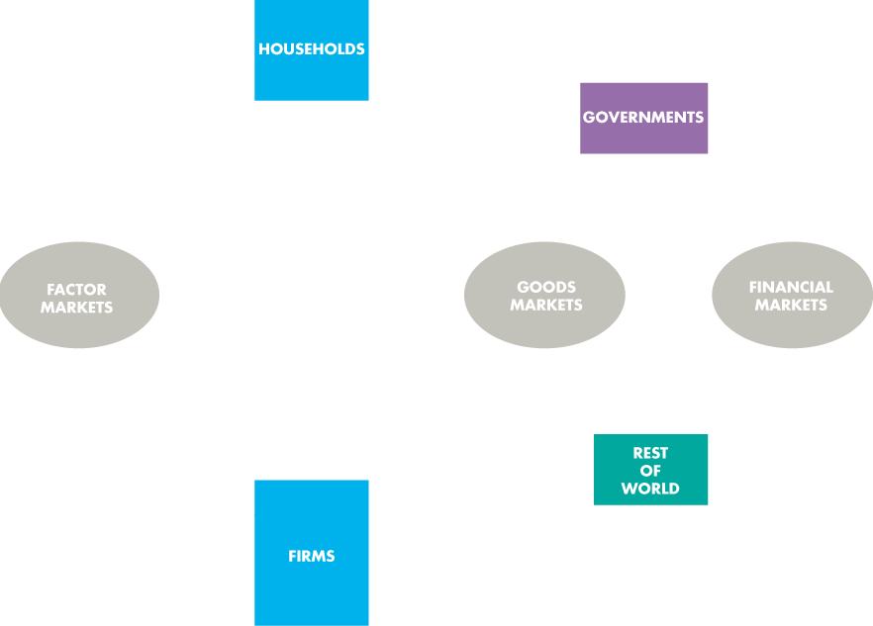
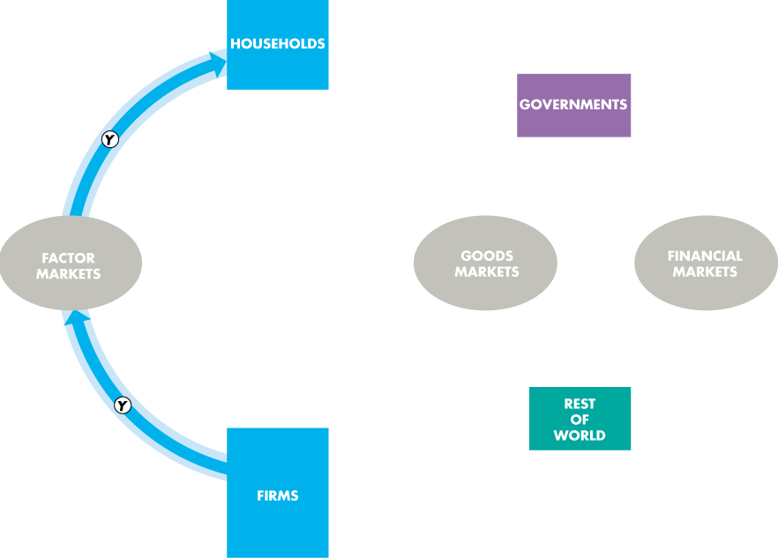
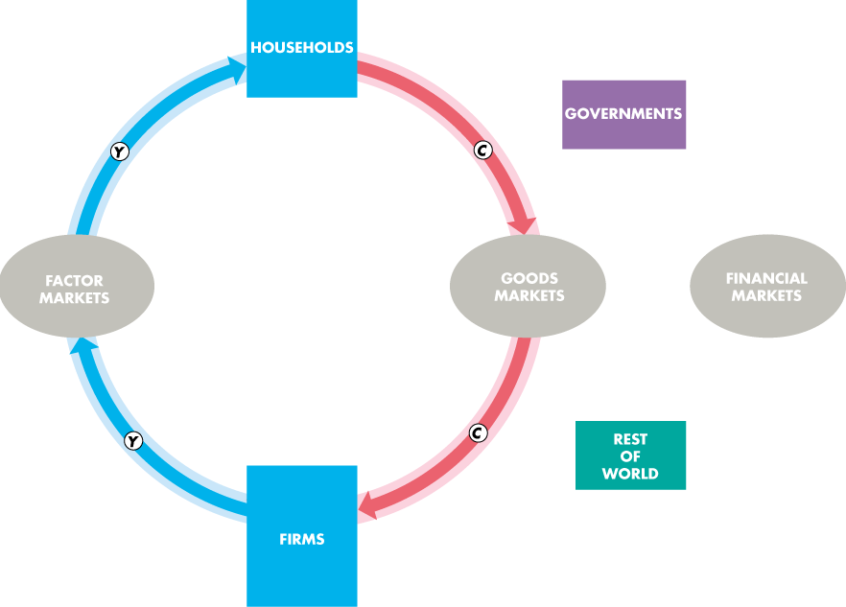
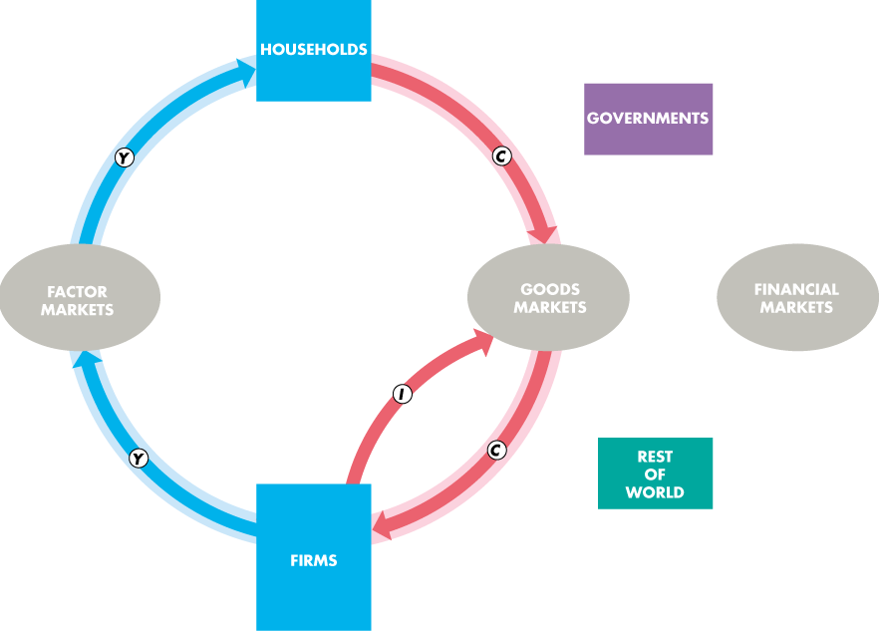

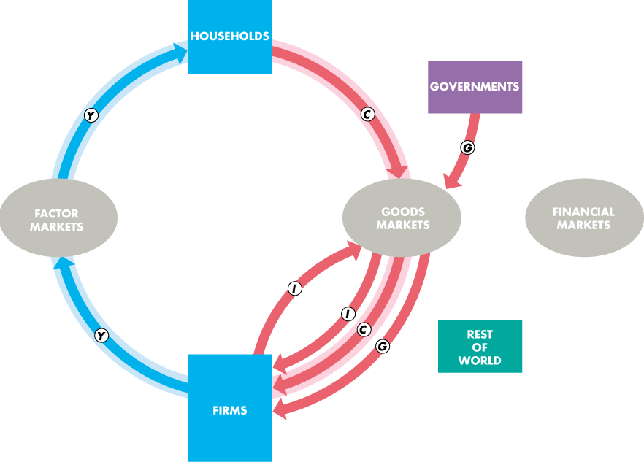
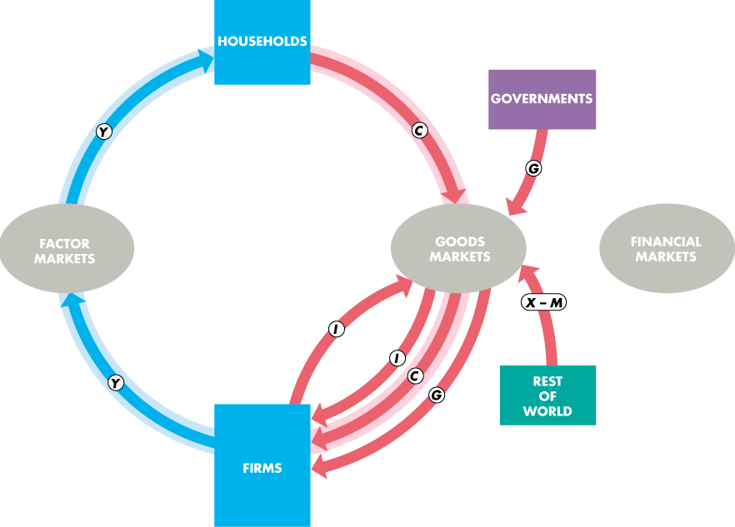
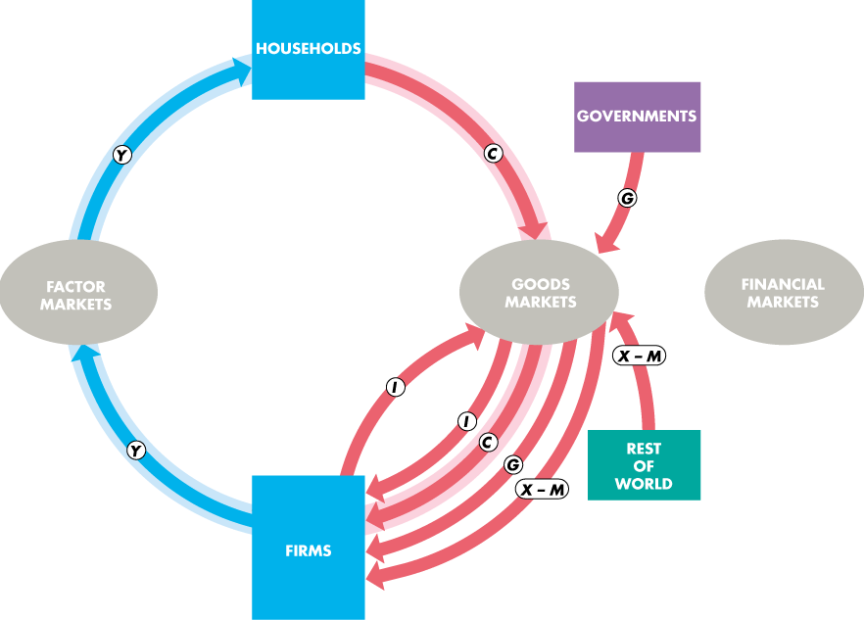
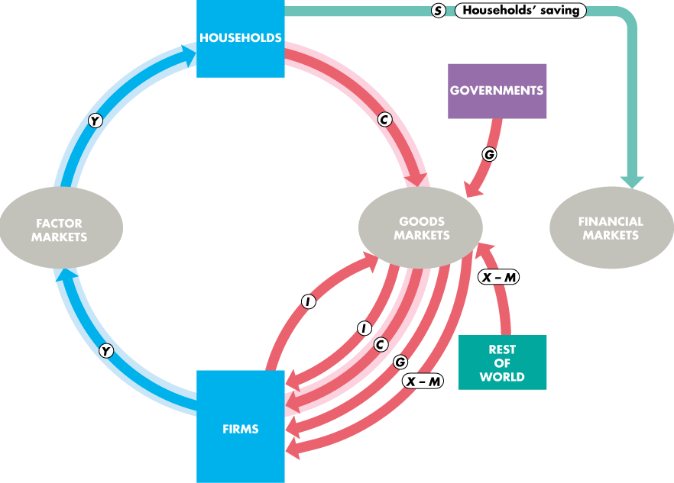
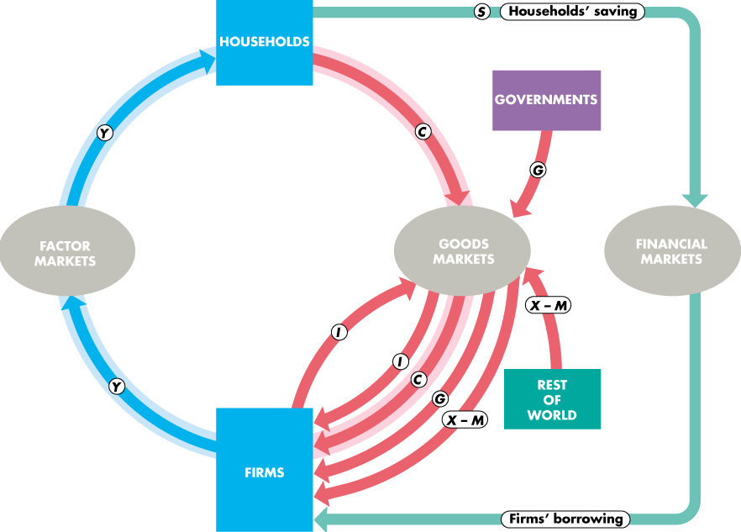
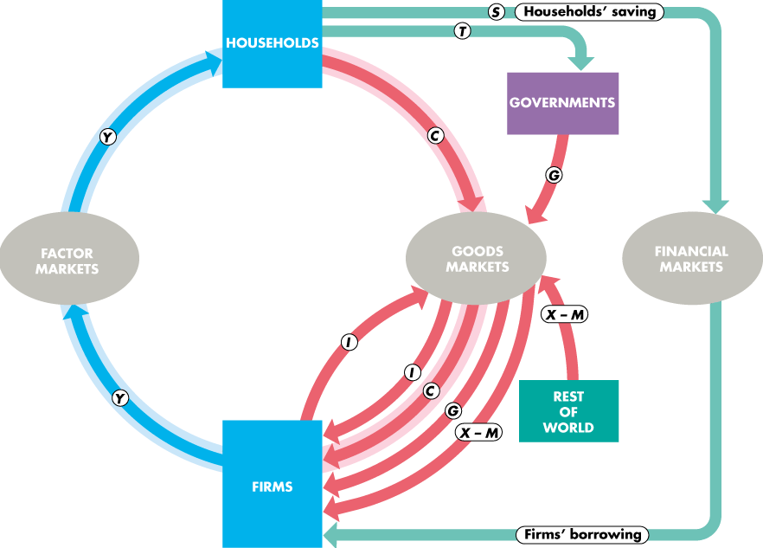
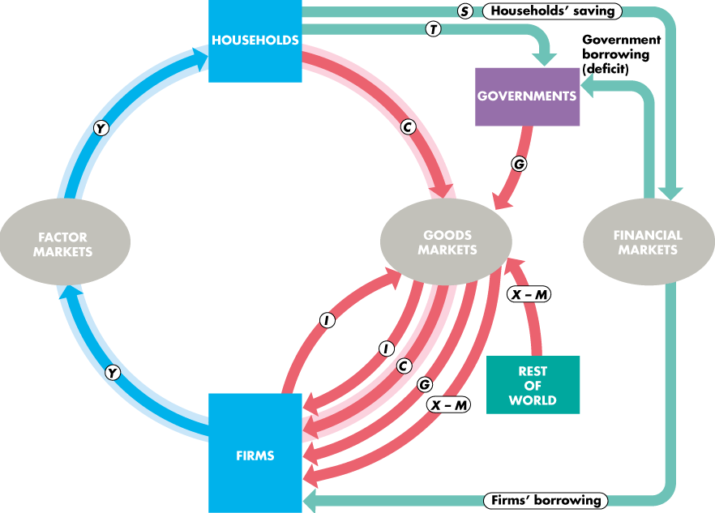
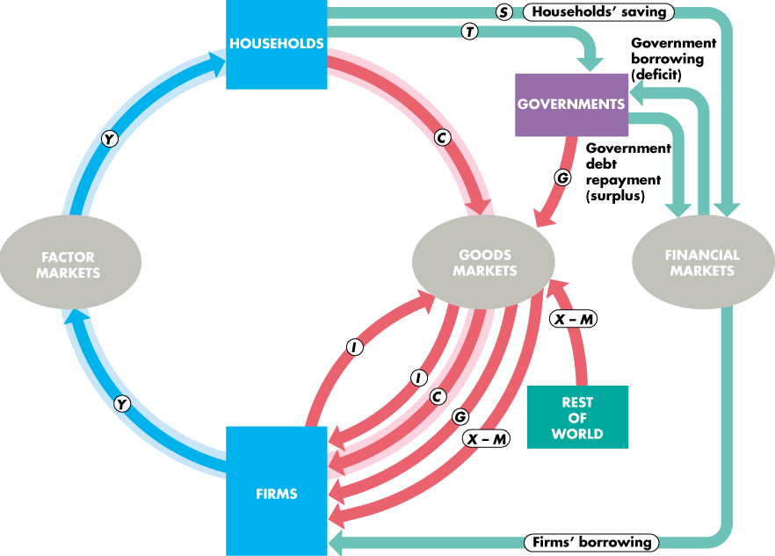
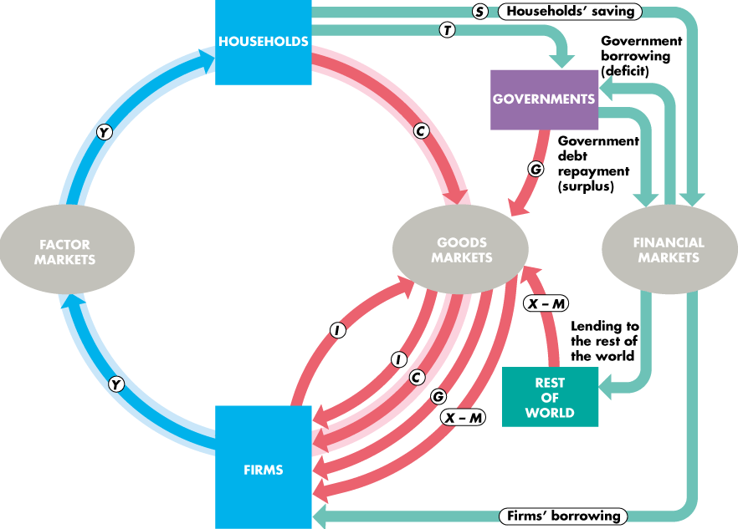
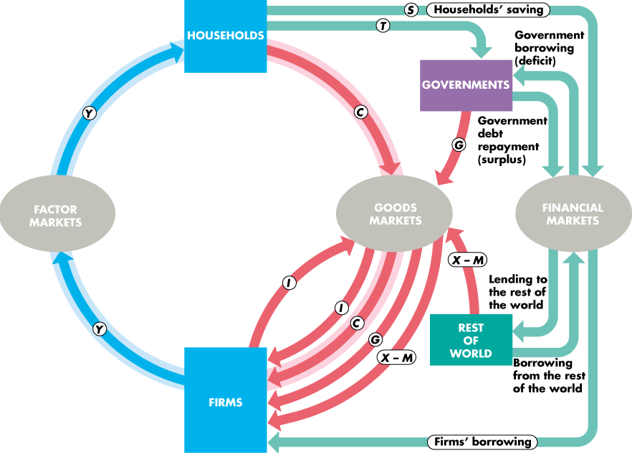

Slide 23
The Loanable Funds Market
  The Real Interest Rate
  The nominal interest rate is the number of dollars that a borrower pays and a lender receives in interest in a year expressed as a percentage of the number of dollars borrowed and lent.
  For example, if the annual interest paid on a $500 loan is $25, the nominal interest rate is 5 percent per year.

Slide 24
Finantial Flow and the circular flow of Expenditure and Income
households -use their income for consumption(C), paying taxes(T),saving (S)
Firms -borrow to finance investment expenditure(I)
Government -collect taxus (T), have expendites (G), borrow to finance a budget deficit or repay debt with a budget surplus
World -engages in borrowing (deficit) and lending (surplus) activities

Slide 25
The Real Interest Rate
  The Nominal Interest Rate is the the numebr of dollars that a borrower pays and a lender in interest in a year expressed as a percentage of the number of dollars borrowd and lent

Slide 26
The Loanable Funds Market
  The real interest rate is the nominal interest rate adjusted to remove the effects of inflation on the buying power of money.
  The real interest rate is approximately equal to the nominal interest rate minus the inflation rate.
  For example, if the nominal interest rate is 5 percent a year and the inflation rate is 2 percent a year, the real interest rate is 3 percent a year.
  The real interest rate is the opportunity cost of borrowing.

Slide 27
The nominal interest rate, the real interest rate and inflation rae related approcimately as follows:
Real Interest Rate=Nominal interest rate-Inflation Rate
The nominal interest rate tells you how fast the number of dollars in your bank account rises over time
The rate of inflation tells you how fast the prices of things you want to buy with thoses dollars are rising.
The real interest rate, the difference between theses two measures, tells you how fast the puechasing power if your bank account rises over time.

Slide 28
The Loanable Funds Market
  The market for loanable funds determines the real interest rate, the quantity of funds loaned, saving, and investment.
  We’ll start by ignoring the government and the rest of the world.
  The Demand for Loanable Funds
  The quantity of loanable funds demanded depends on
  1. The real interest rate (movement along the curve)
  2. Expected profit (shift the curve)

Slide 29
The Loanable Funds Market
The Demand for Loanable Funds Curve (DLF)
  The demand for loanable funds is the relationship between the quantity of loanable funds demanded and the real interest rate when all other influences on borrowing plans remain the same.
  Business investment is the main item that makes up the demand for loanable funds.
  (we are considering only firms,but not household or in/export)

Slide 30
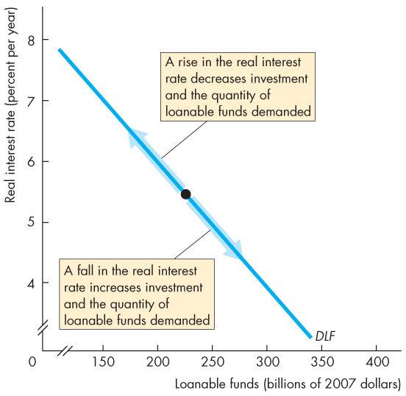
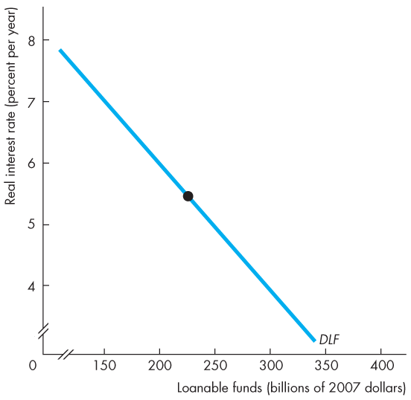
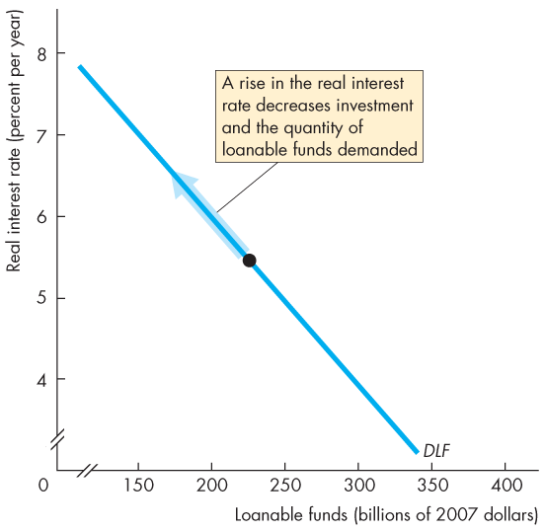
The Market for Loanable Funds
  Figure 23.3 shows the demand for loanable funds curve.
  A rise in the real interest rate decreases the quantity of loanable funds demanded.
  A fall in the real interest rate increases the quantity of loanable funds demanded.
  (if interest rate is high, firms are going to borrow less)

Slide 32
The Loanable Funds Market
Changes in the Demand for Loanable Funds
  When the expected profit changes, the demand for loanable funds changes.
  Other things remaining the same, the greater the expected profit from new capital, the greater is the amount of investment and the greater the demand for loanable funds.
  (DLF shifts to the right)

Slide 33
The Loanable Funds Market
  The Supply of Loanable Funds--SLF (recall slide 10?)
  The quantity of loanable funds supplied depends on
  1. The real interest rate (movement along the curve)
  2. Disposable income (increse in Y-T)--increasing SLF
  3. Expected future income (decrese Y)--increasing SLF
  4. Wealth (decrease wealth)--increasing SLF
  5. Default risk (decrese DR)--increase in SLF

Slide 34
Default risk and supply of loanable Funds
Any changes that decreases the default risk of an asset increases lenders' willingness to supply loanable funds at any interest rate, shifting the SLF to the right and reducing the interest rate.
Any changes that increases the default risk of an asset decreases lender's willingness to supply loanable funds at any interest rate, shifting the SLF to the left and increasing the interest rate to compendate lenders for bearing the additional risk.

Slide 35
The Loanable Funds Market
The Supply of Loanable Funds Curve
  The supply of loanable funds is the relationship between the quantity of loanable funds supplied and the real interest rate when all other influences on lending plans remain the same.
  Saving is the main item that makes up the supply of loanable funds.
  (demand comes from the firms and supply comes from the saving)

Slide 36
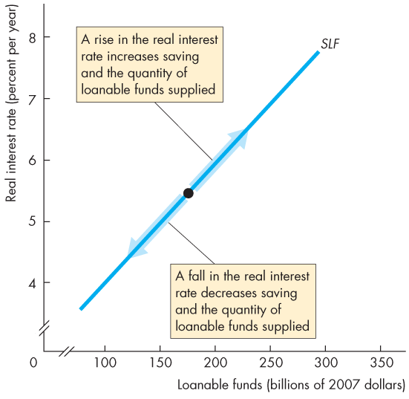
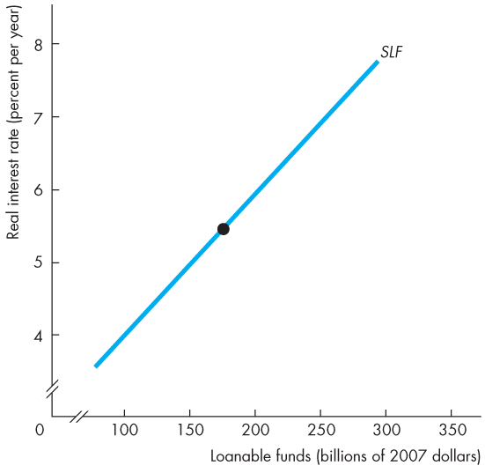
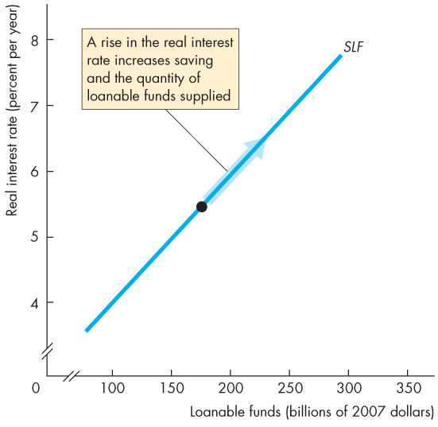
The Market for Loanable Funds
  Figure 23.4 shows the supply of loanable funds curve.
  A rise in the real interest rate increases the quantity of loanable funds supplied.
  A fall in the real interest rate decreases the quantity of loanable funds supplied.
  (if the rate is high, ppl tend to save more)

Slide 38
The Loanable Funds Market
Changes in the Supply of Loanable Funds
  A change in disposable income, expected future income, wealth, or default risk changes the supply of loanable funds.
  An increase in disposable income, a decrease in expected future income, a decrease in wealth, or a fall in default risk increases saving and increases the supply of loanable funds.
  (NOT MENTIONED)

Slide 39
The Loanable Funds Market
  Equilibrium in the Loanable Funds Market
  The loanable funds market is in equilibrium at the real interest rate at which the quantity of loanable funds demanded equals the quantity of loanable funds supplied.

Slide 40
The Loanable Funds Market
  Figure 23.5 illustrates the loanable funds market.
  At 7 percent a year, there is a surplus of funds and the real interest rate falls.
  (more loanable funds, less saving will occur)
  At 5 percent a year, there is a shortage of funds and the real interest rate rises.
  (not lot of ppl want to buy,firms tend to buy, ther is a shortage of loanable funds )
  Equilibrium occurs at a real interest rate of 6 percent a year.

Slide 41
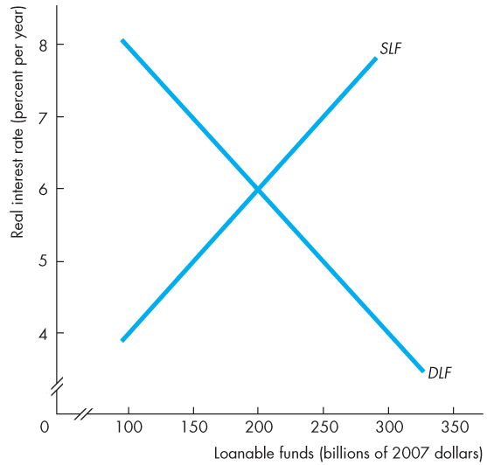
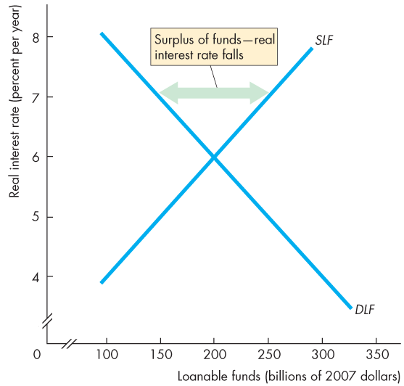
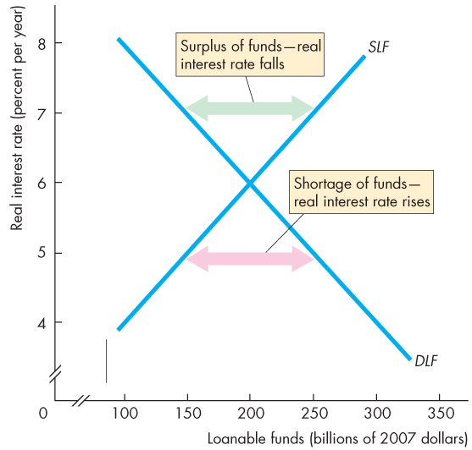
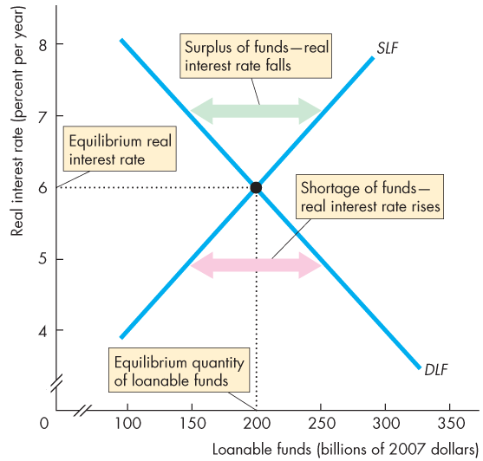
The Process to Equilibrium
SLF > DLF
DLF >SLF

Slide 42
The Loanable Funds Market
  Changes in Demand and Supply
  Financial markets are highly volatile in the short run but remarkably stable in the long run.
  Volatility comes from fluctuations in either the demand for loanable funds or the supply of loanable funds.
  These fluctuations bring fluctuations in the real interest rate and in the equilibrium quantity of funds lent and borrowed.
  They also bring fluctuations in asset prices.
  (NOT MENTIONED)

Slide 43
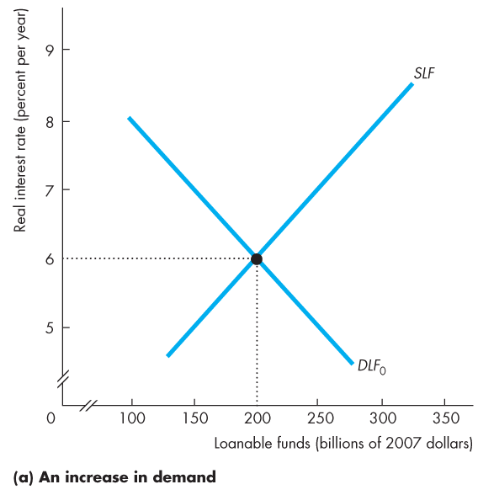
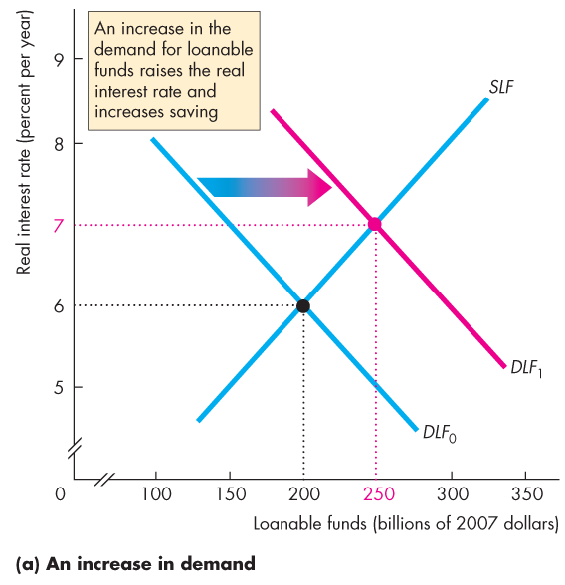
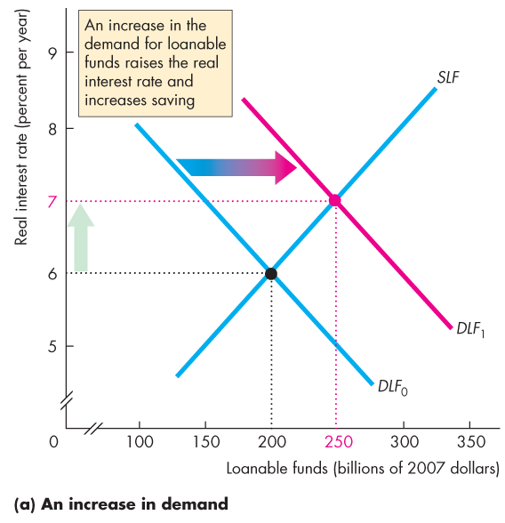
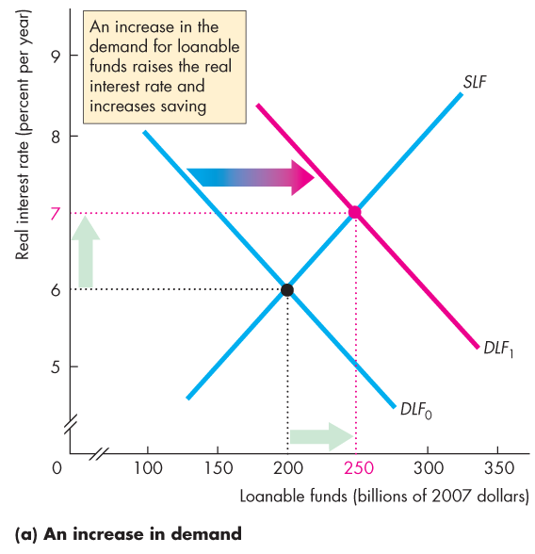
The Loanable Funds Market
  Figure 23.6(a) illustrates an increase in the demand for loanable funds.
  An increase in expected profits increases the demand for funds today.
  The real interest rate rises.
  Saving and quantity of funds supplied increases.

Slide 44
DLF>SLF

Slide 45
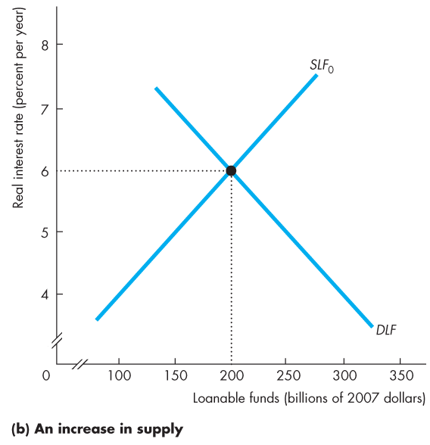
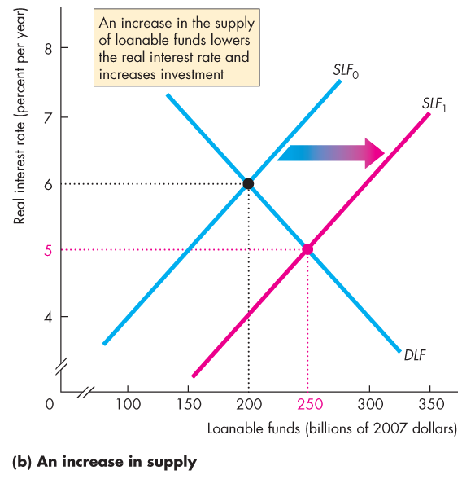
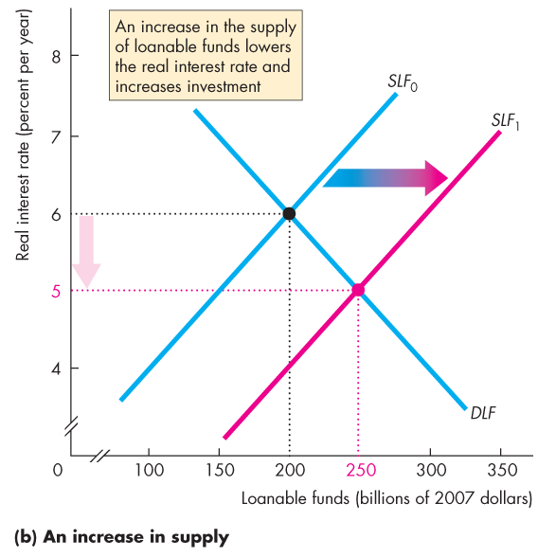

The Loanable Funds Market
  Figure 23.6(b) illustrates an increase in the supply of loanable funds.
  If one of the influences on saving plans changes and saving increases, the supply of funds increases.
  The real interest rate falls.
  Investment increases.

Slide 46
SLF>DLF

Slide 47
Government in the Loanable Funds Market
  Government enters the financial loanable market when it has a budget surplus or deficit.
  A government budget surplus increases the supply of funds.
  A government budget deficit increases the demand for funds.

Slide 48
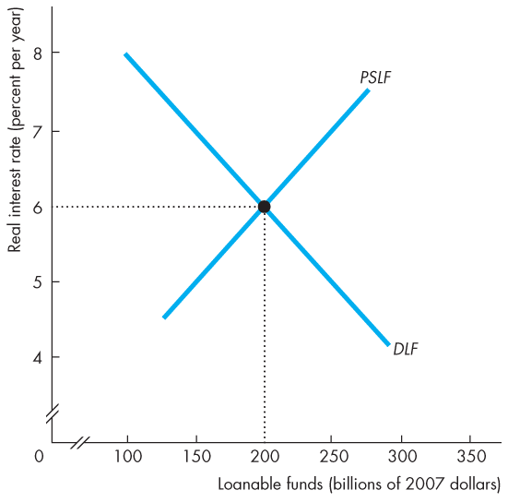
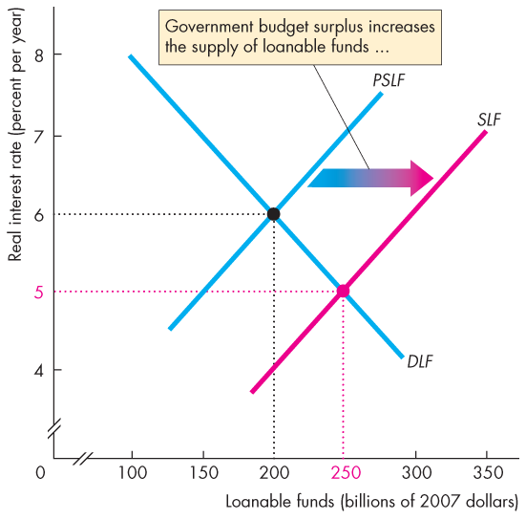
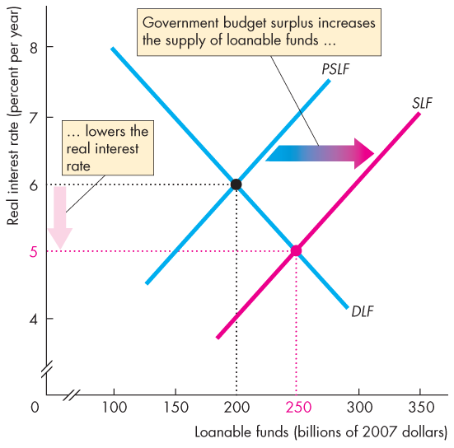
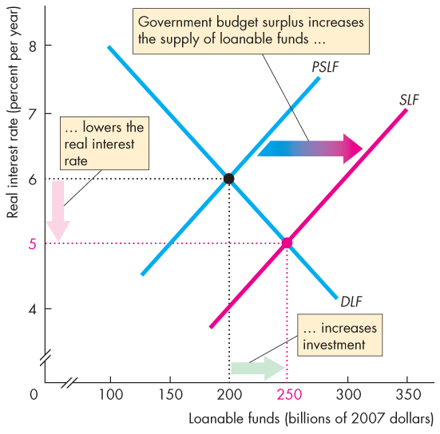
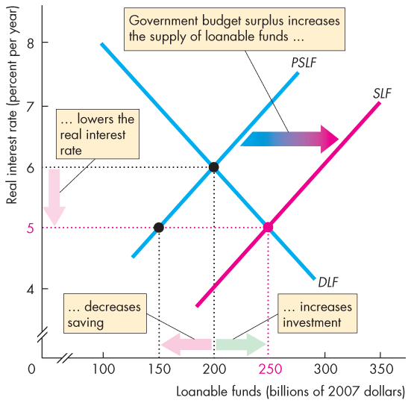
Government in the Market for Loanable Funds
  Figure 23.7 illustrates the effect of a government budget surplus.
  A government budget surplus increases the supply of funds.
  The real interest rate falls.
  Investment increases.
  Saving decreases.

Slide 49
the new eqilibrium happens at 250, when government puts momey into this system
demand is not chaging, so we have demand greater than demand
-savers may consider saving less as the interest rate falls
-firms are borrowing more
--thats why the new equilibrium

Slide 50
A Government Budget Surplus
Fig.23.7 ppg 554
Start in quilibrium at point A where PSLF=DLF
Assume the government budget surplus is 100billion
Therefore, the SLF curve is shifted to the right.
Now, SLF>DLF and the real interest rate starts to fall
As the interest rate falls, investment increases along the DLF curve to the point B, and private saving falls along the PSLF urve
IN equilibrium, SLF=DLF at point B
The additional investment is financed by some private saving plus the budget surplus.
(investment here is quantity demanded, )

Slide 51
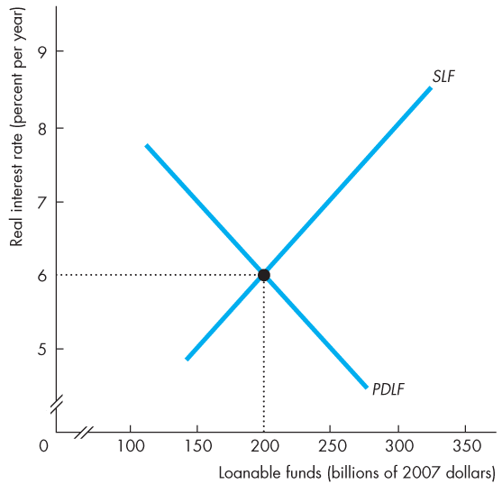
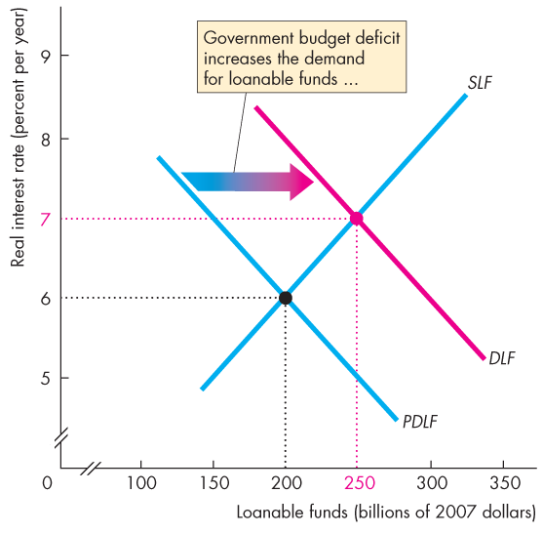
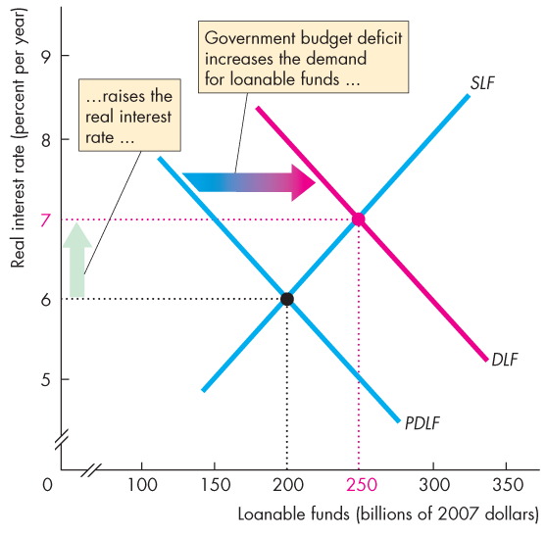
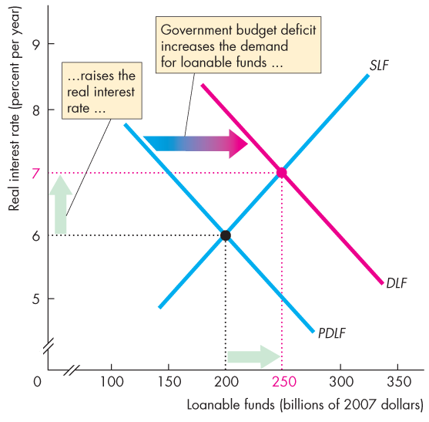
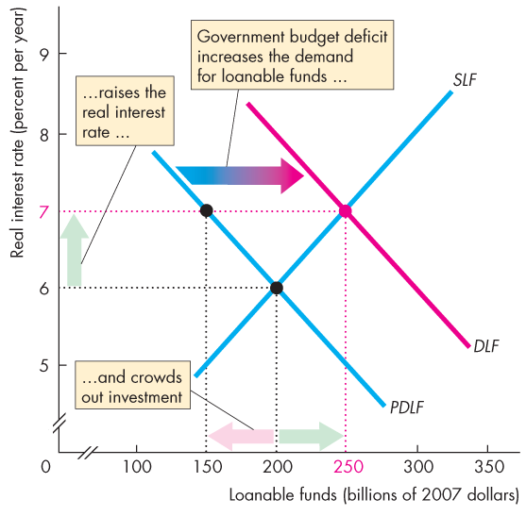
Government in the Market for Loanable Funds
  Figure 23.8 illustrates the effect of a government budget deficit.
  A government budget deficit increases the demand for funds.
  The real interest rate rises.
  Saving increases.
  Investment decreases.

Slide 52
As the interest rate rises, ppl save more and firm borrow less
DLF>SLF
=PDLF+deficit
=Private demand LF

Slide 53
A Government Budget Surplus
Fig.23.8 ppg 555
Start in quilibrium at point A where SLF=PDLF
Assume the government budget deficit is 100billion
Therefore, the DLF curve shifts to the right.
Now, DLF>SLF and the real interest rate starts to rise
As the interest rate rises, investment decreases along the PDLF curve to the point B, and private saving increases along the SLF curve
In equilibrium, SLF=DLF at point B
Investment decreasesbecause private saving is diverted to finance the deficit.
We call this crowding-out of investment

Slide 54
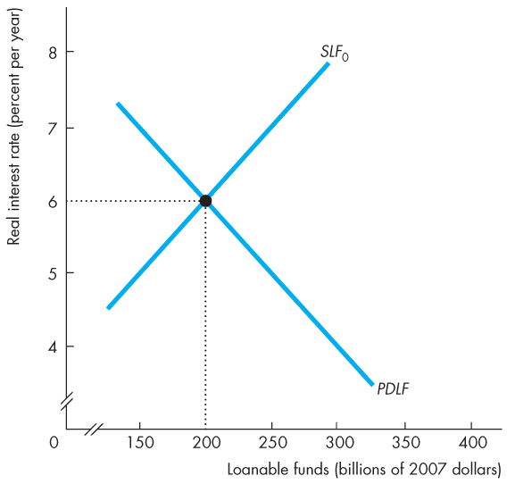
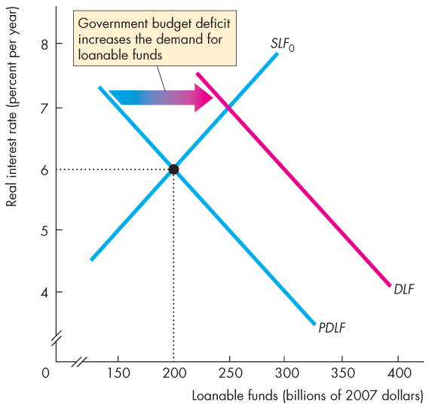
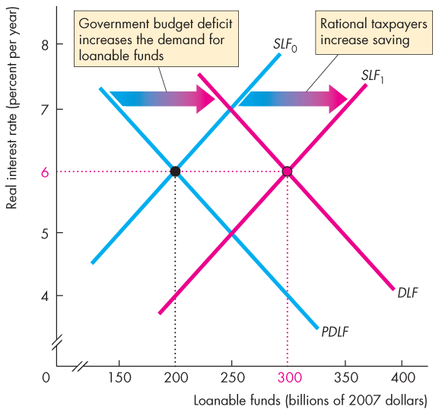

Government in the Market for Loanable Funds
  Figure 23.9 illustrates the Ricardo-Barro effect.
  A budget deficit increases the demand for funds.
  Rational taxpayers increase saving, which increases the supply of funds.
  Crowding-out is avoided.
  Increased saving finances the deficit.

